Slide 1


http://www.bonrix.in
Open Source Android App Store
http://www.myappstore.co.in
https://github.com/open-source-app-store
Website:
Address:
M/S. Bonrix Software Systems
A-801, Samudra Complex,
Near Classic Gold Hotel, Off. C. G. Road,
Navrangpura,
Ahmedabad - 380009, Gujarat, India.
Email-Id:
bonrix@gmail.com
info@bonrix.net
Contact us: +91- 94290 45500
Skype id:
bonrix_sms

Slide 2
AndroidAppStore-website
AndroidAppStore is open source web project developed in C# ASP.net for Distributing Android APP Easily from website. There options for easy APK uploading, sharing and downloading.

Slide 3
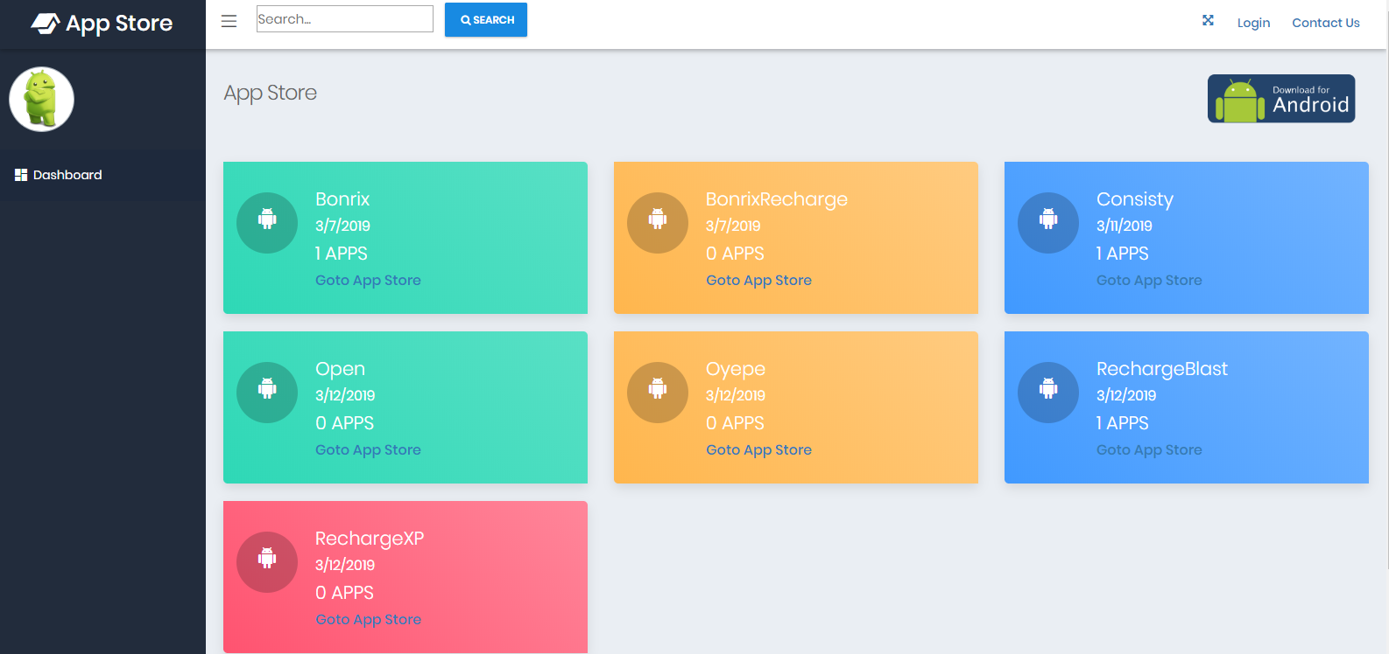
Bonrix App Store Main Page
Welcome to Bonrix App Store Main Page..!!

Slide 4
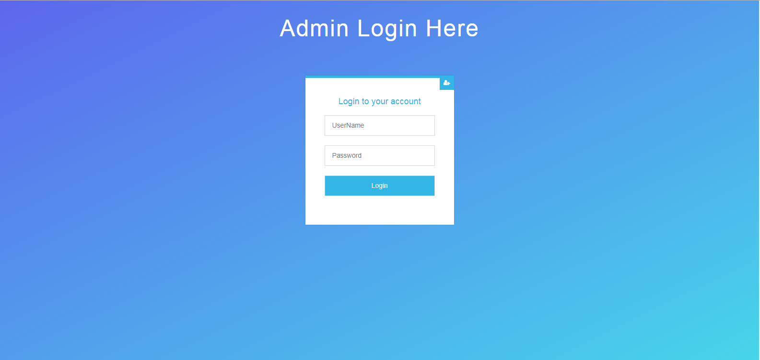
Admin Login page for Bonrix App Store
You can use app store with entered USERNAME and PASSWORD.

Slide 5
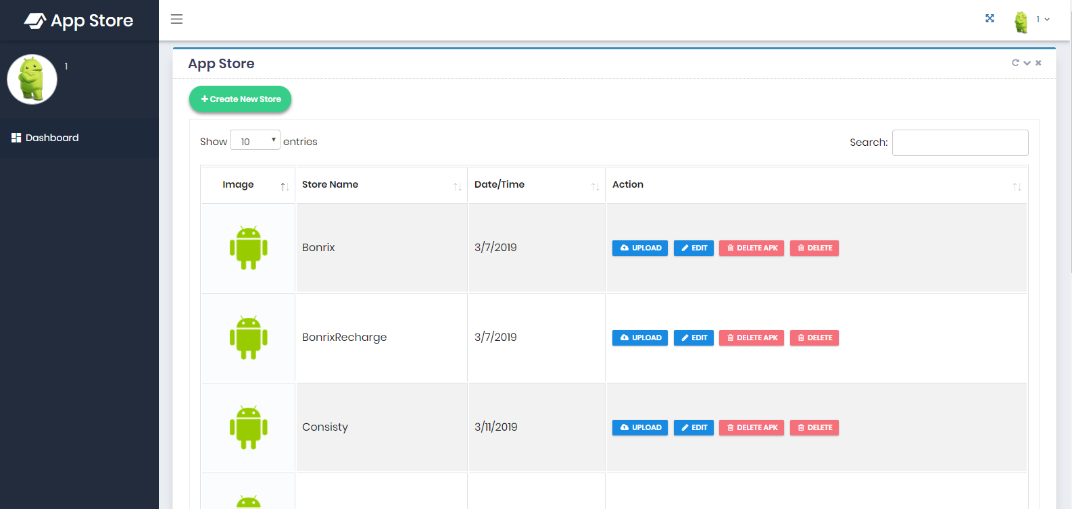
Admin Store List for Bonrix App Store
Admin get all the list of STORES with their details.

Slide 6
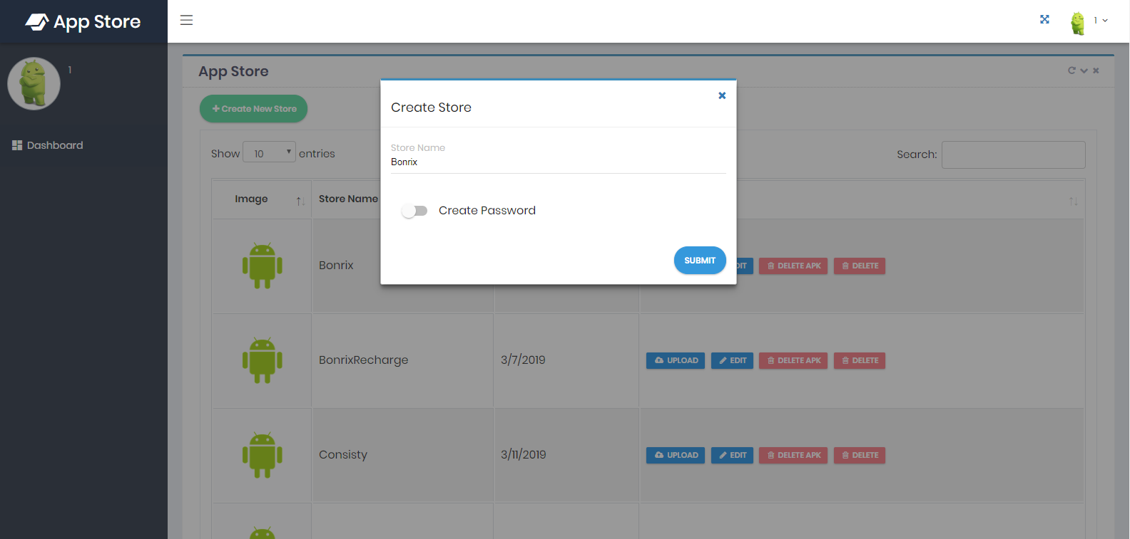
Create New Store by Admin
Admin can create multiple store with separate APK.

Slide 7
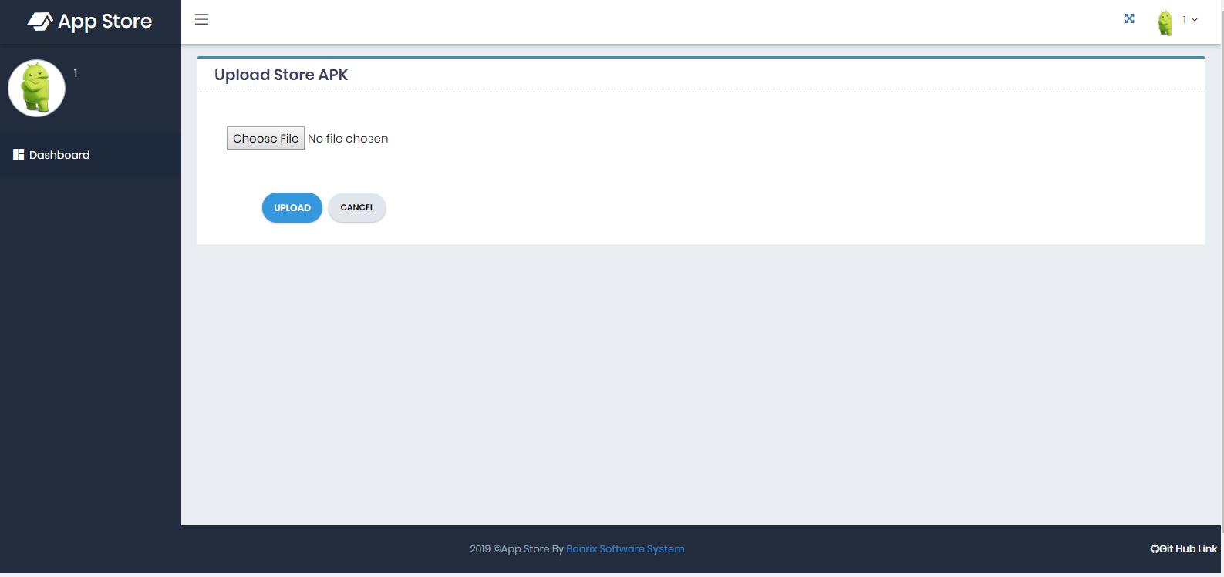
Upload APK to store by Admin
Clicking on upload button admin can upload APK to store.

Slide 8
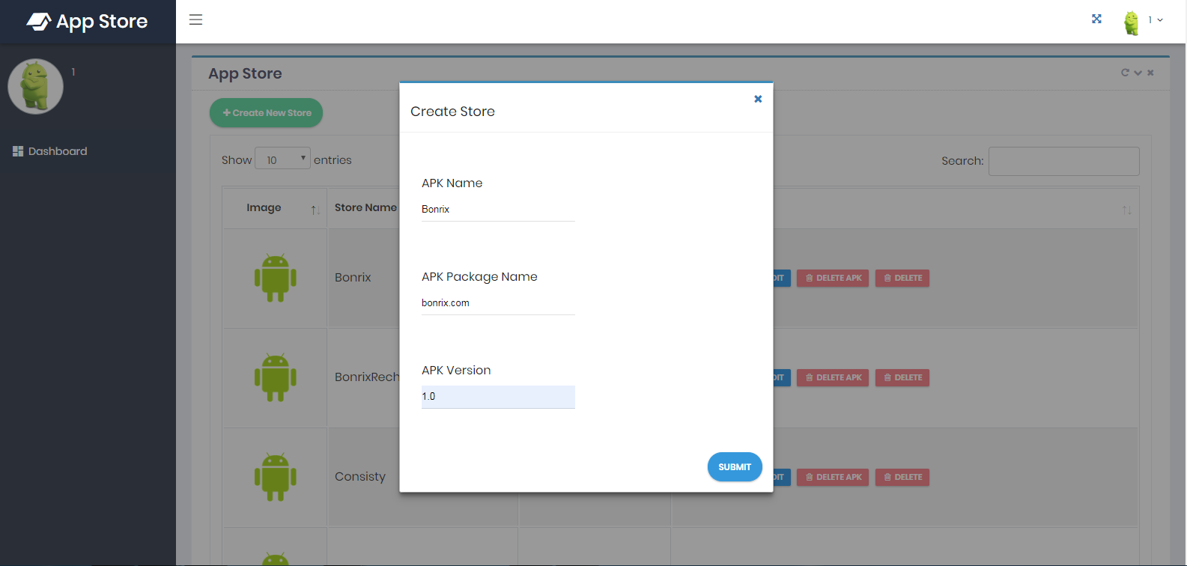
Edit store APK details by Admin
Clicking on EDIT button admin can change details of store APK. Like APK name ,APK package name and APK version.

Slide 9
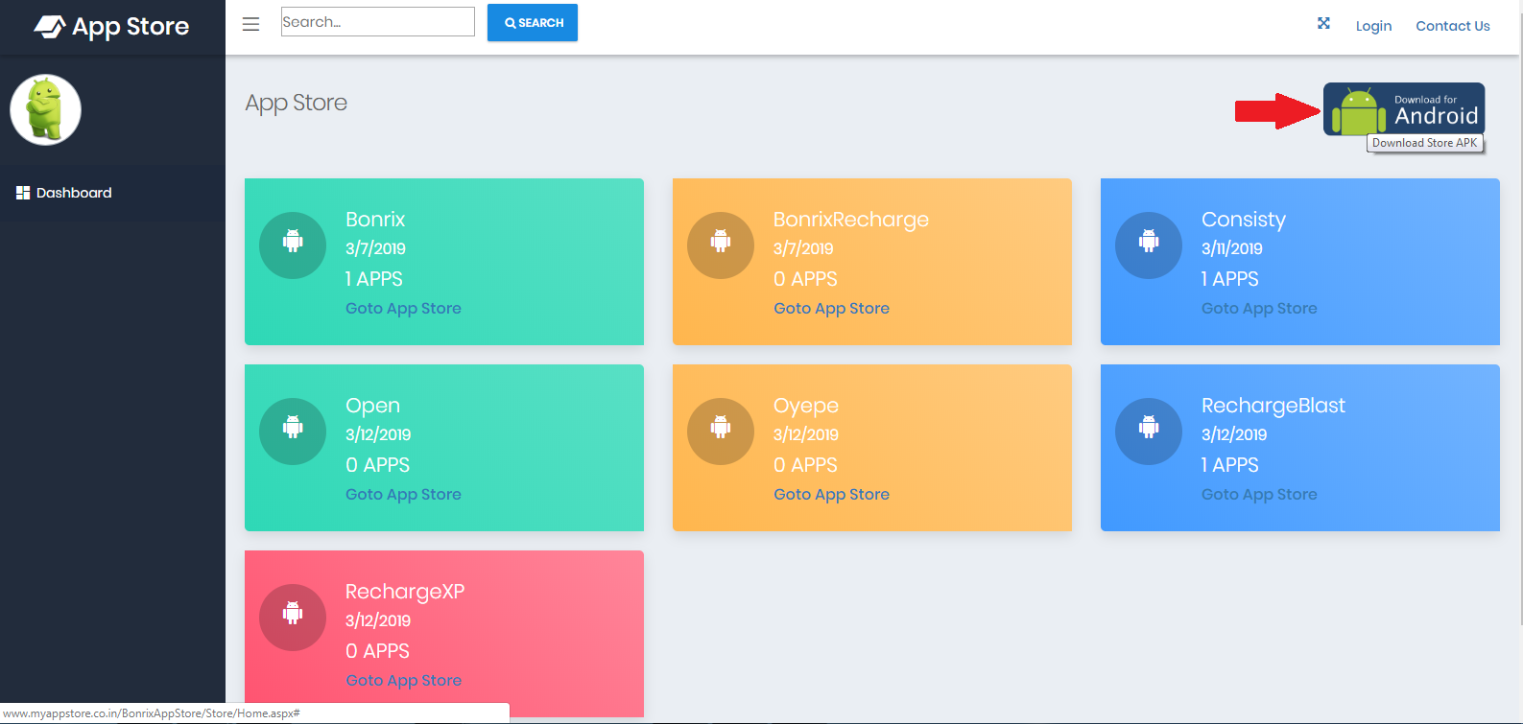
Download Store APK
Clicking on right corner symbol you will get all APK in your System. .

Slide 10
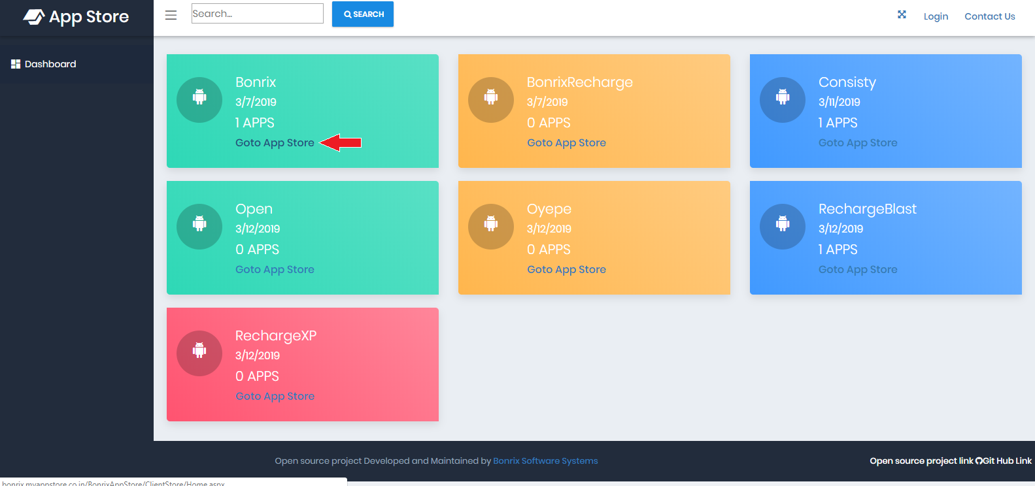
Goto App Store
For checking your personal APK store click on ‘Goto App Store’ .

Slide 11
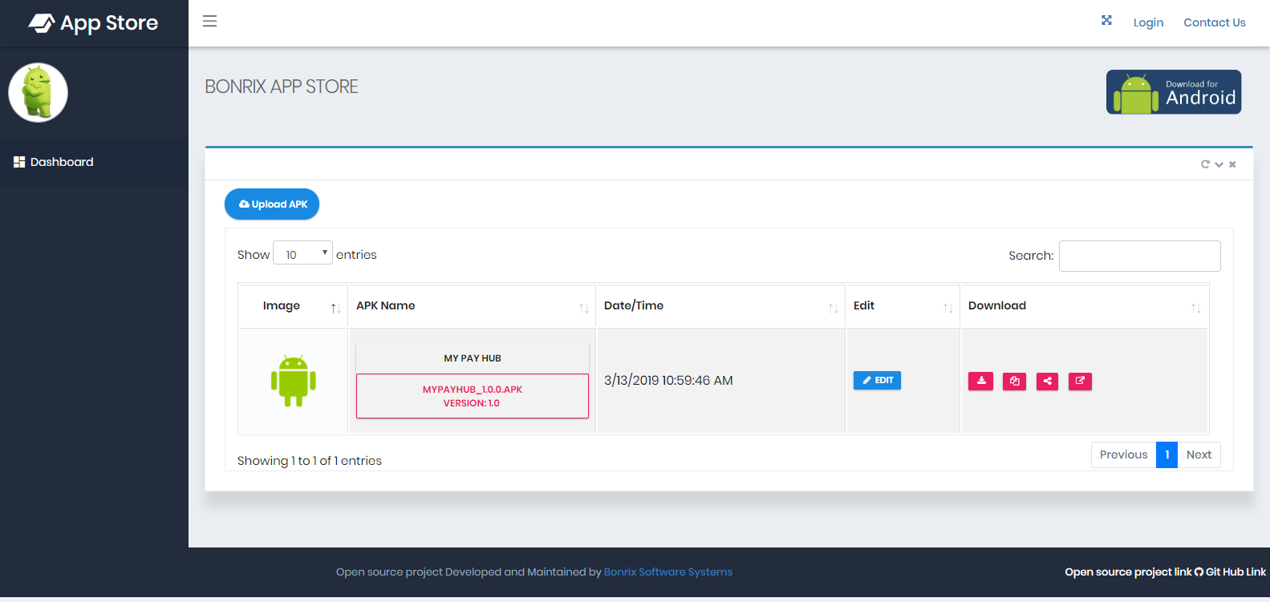
APK Store Main Page
Any user can open APK store from bonrix app store and get list of APK.

Slide 12
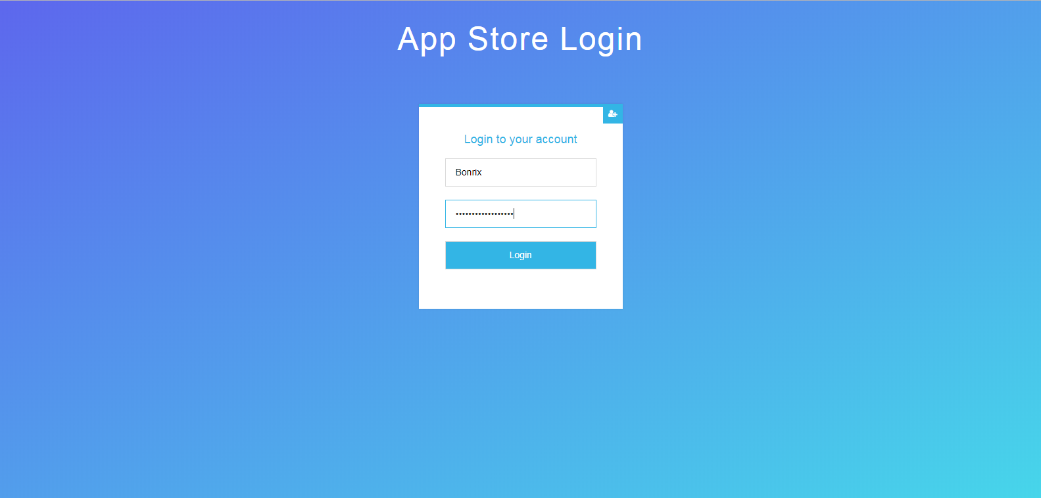
App Store Login
Must login with store name and password for edit the APK details.

Slide 13
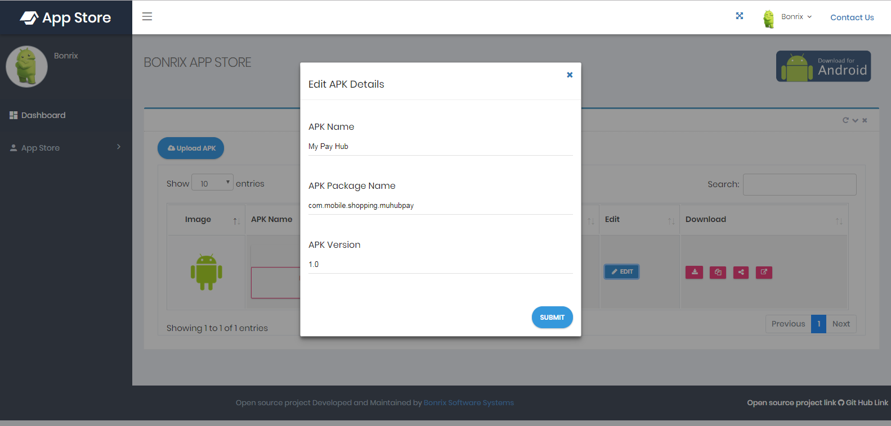
Edit APK for particular Store
After store app login user can edit APK details. Like APK name, APK package and APK version.

Slide 14
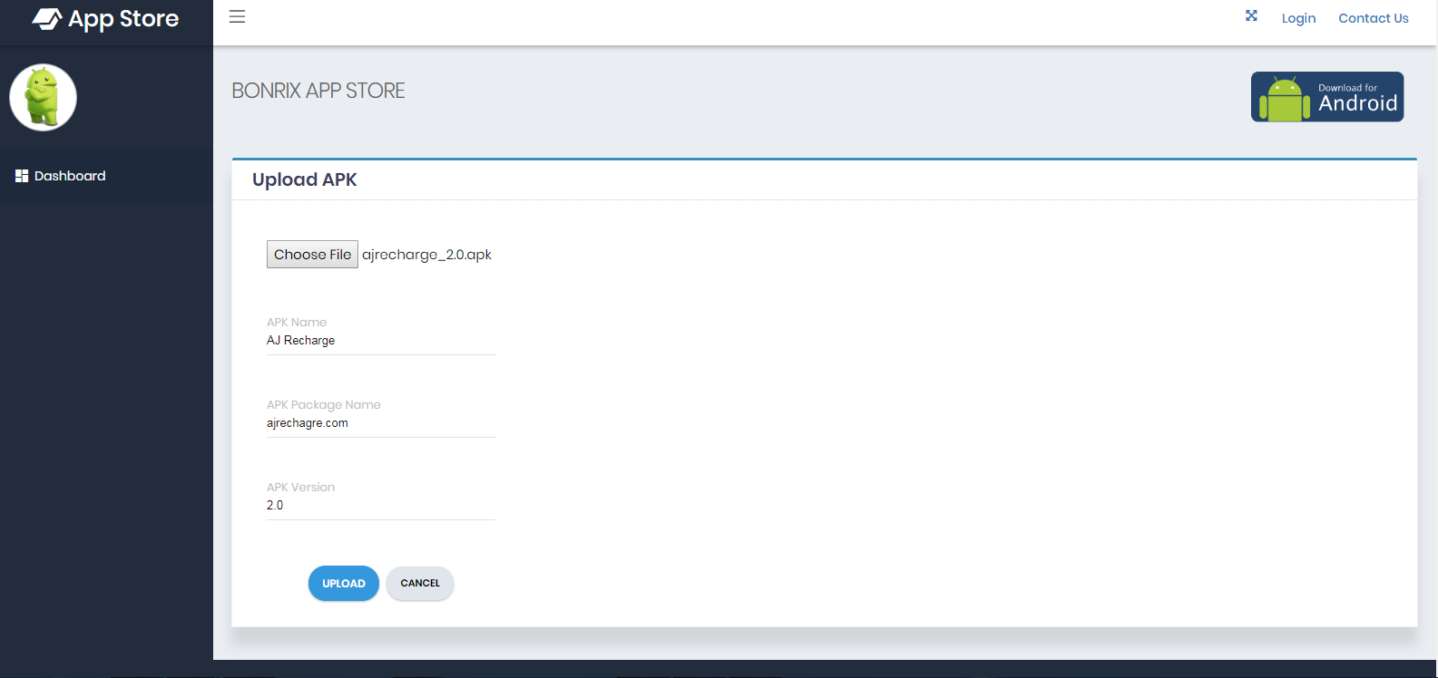
Upload APK to store
Upload your APK to store you have to Click on choose file and select APK; fill details according to APK.

Slide 15
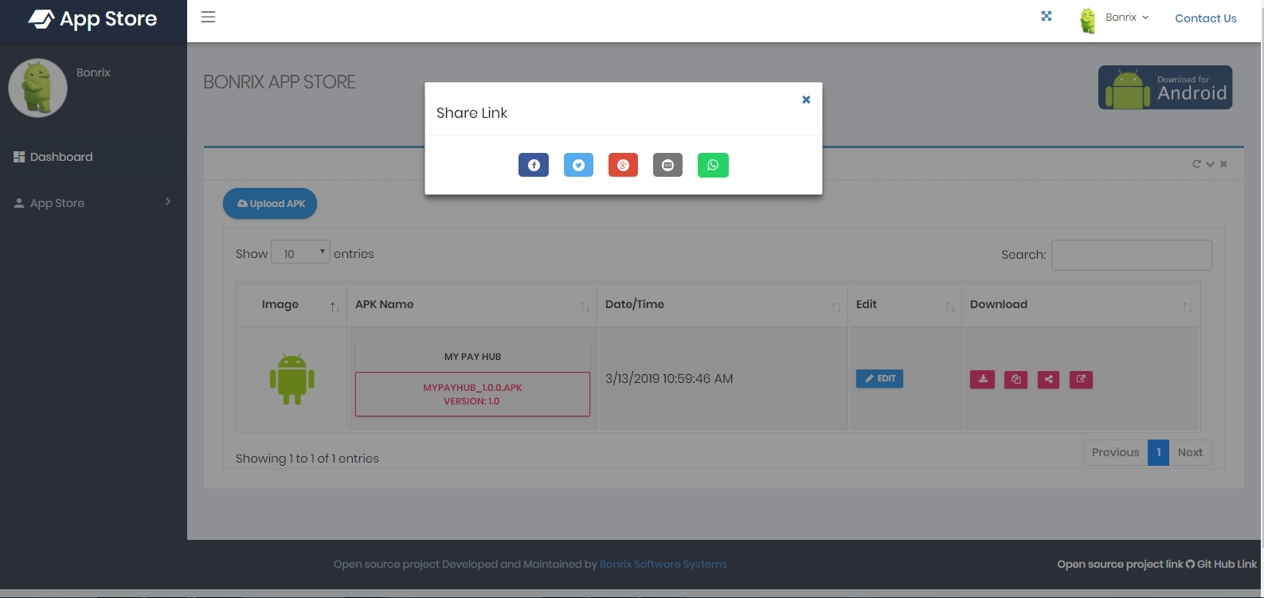
Share APK Link from Store
Any user can share APK link to others via Facebook, Twitter, Gmail , Google and WhatsApp.

Slide 16
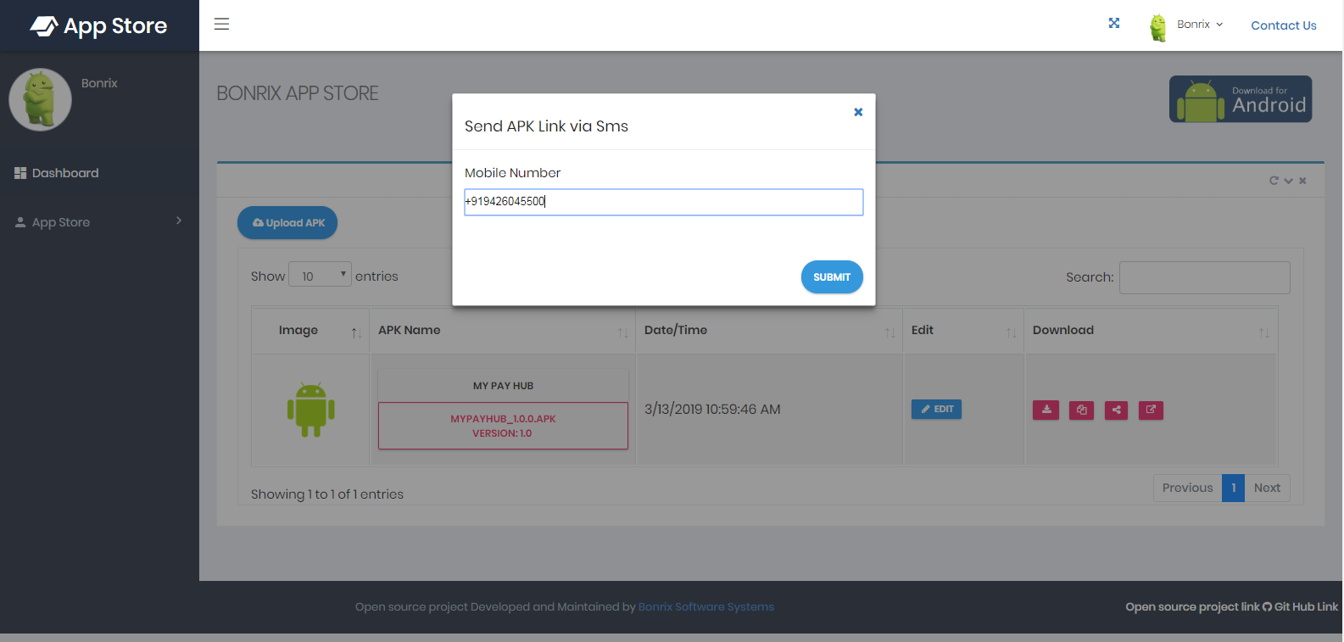
Send APK Link Via SMS
Any user can send APK link to others via SMS to mobile number.

Slide 17
AndroidAppStore-APK
Android App Store APK is open source project - It is an Android App that can download other android app listed on Web based App Store. So there is an App Store where number of Android APK have been already Uploaded. This Android app Download those APK selectively and install it in handset.

Slide 18
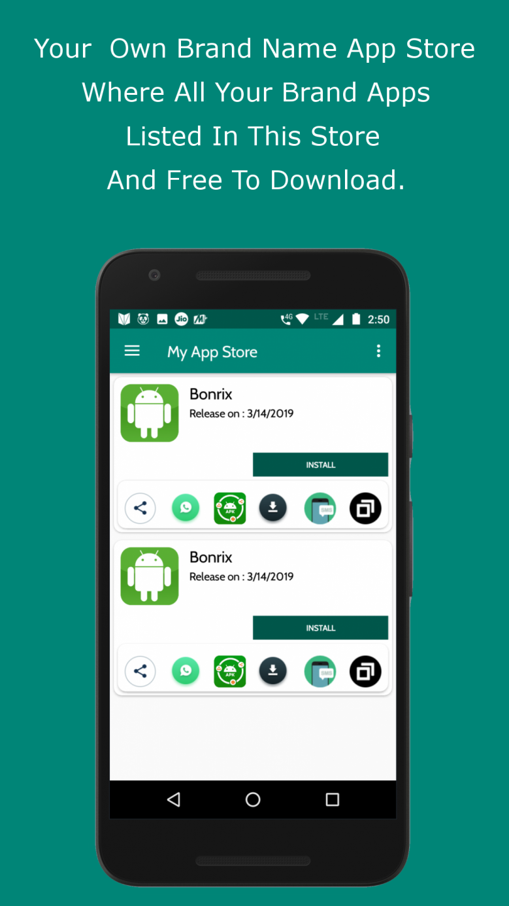
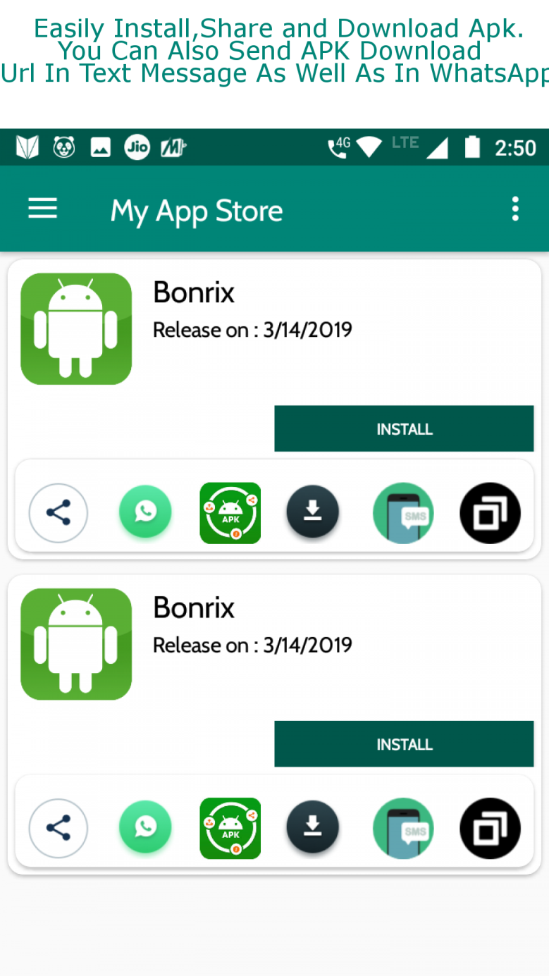

Slide 19
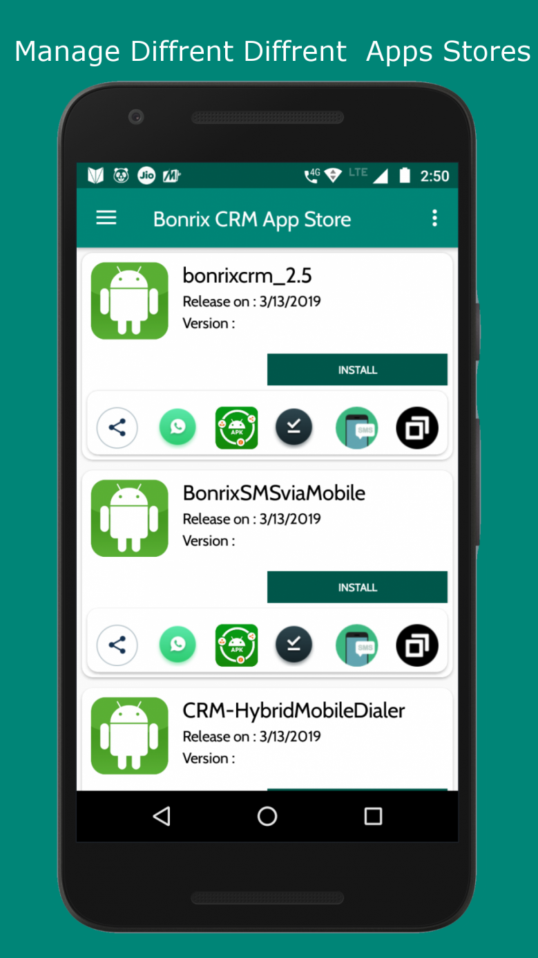
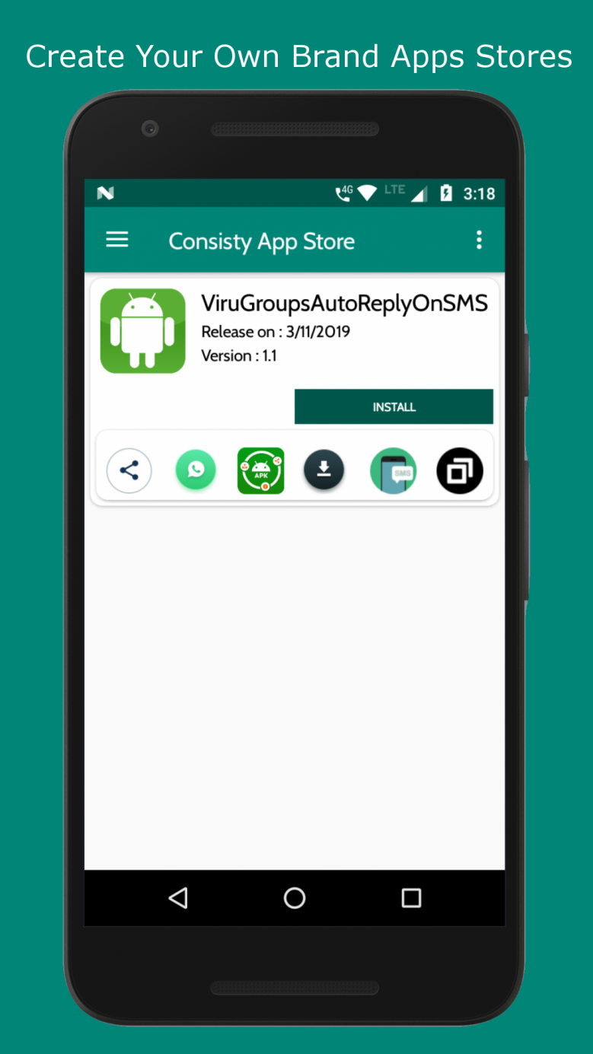

Slide 20
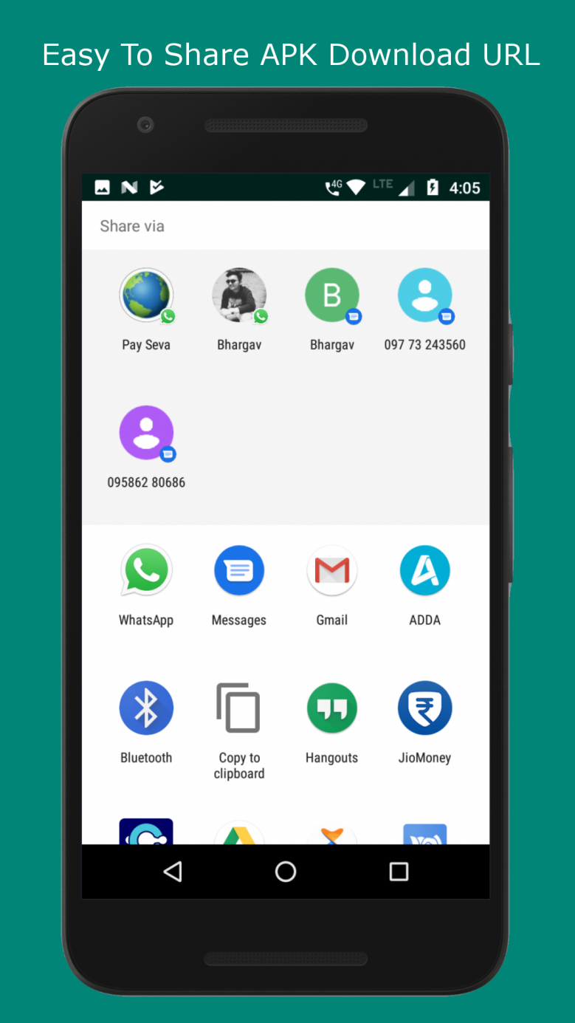
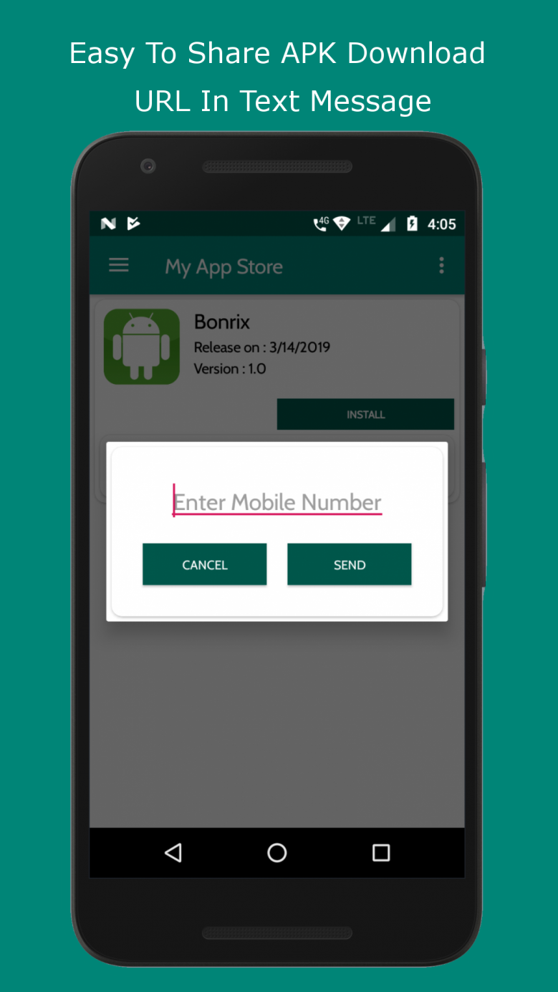

Slide 21
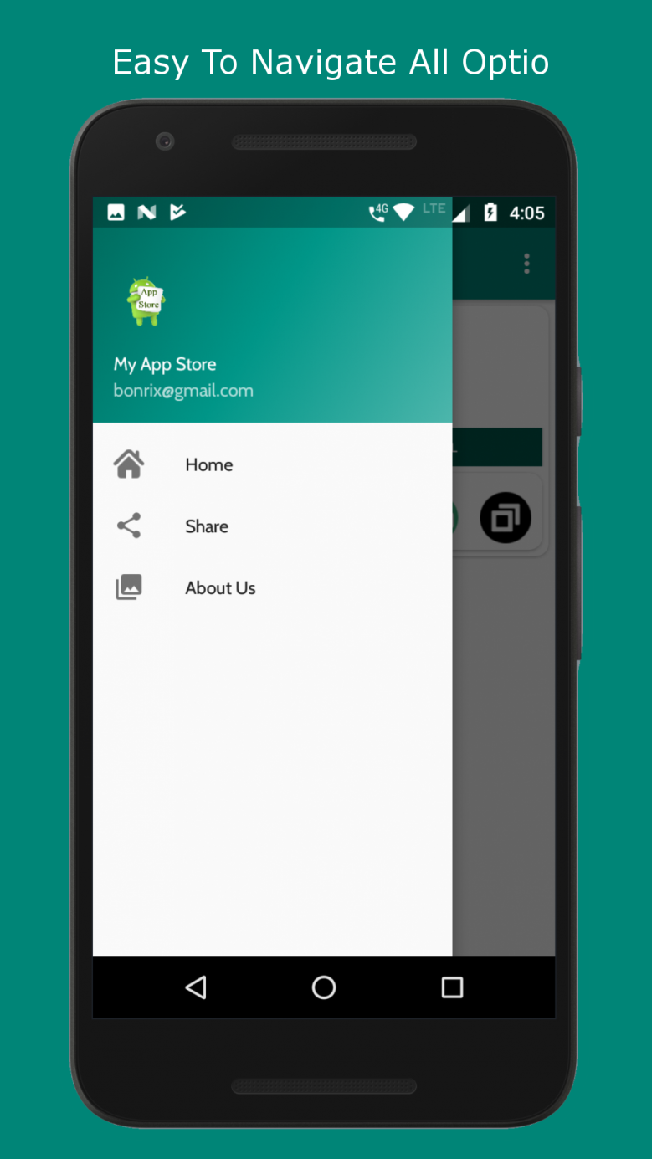
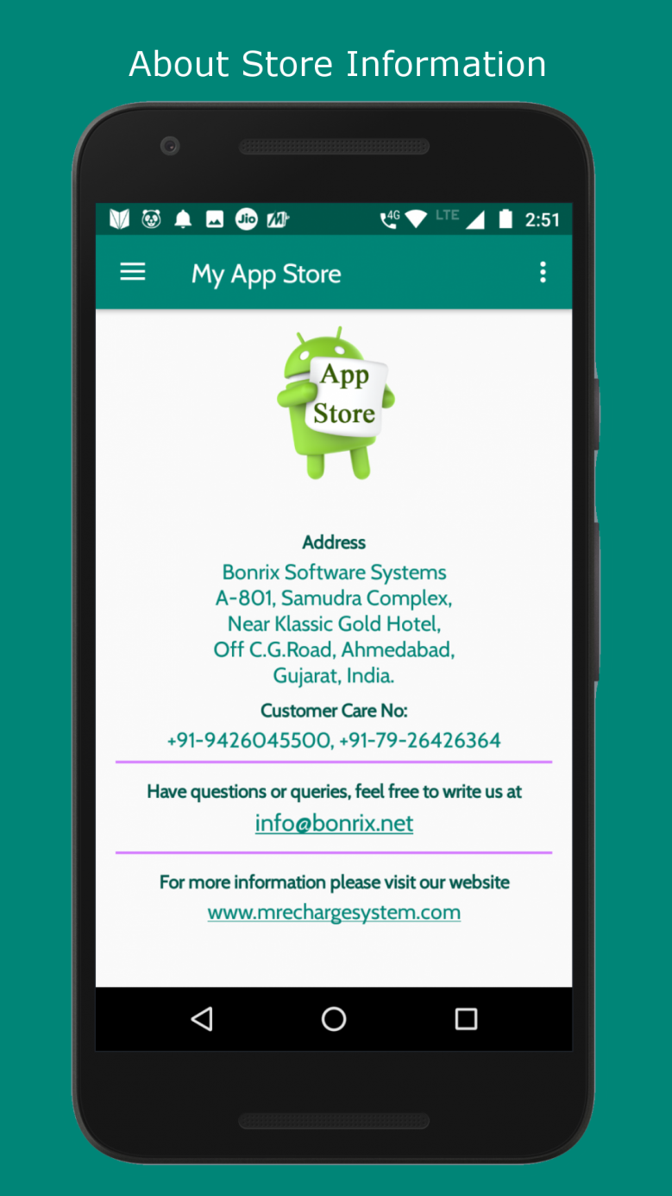

Slide 22

GitHub Links
GitHub link for
Android project
https://github.com/open-source-app-store/AndroidAppStore-APK
GitHub link for
Website project
https://github.com/open-source-app-store/AndroidAppStore

Slide 23








Rechargesystem.bonrix.in
Beacon.Bonrix.in
gpstracker.bonrix.in
android.bonrix.net
pay.bonrix.in
crm.bonrix.in
salescloud.bonrix.in
myshoppingcart.bonrix.in

Slide 24




















gpstracker.in
smsviamobile.com
mautodialer.com
LiveQuotes.co.in
mvoicecall.com
epartnerchannel.com
smsviasmpp.com
smpp2smpp.com
mandroidpos.com
callcentersoftware.co.in
tablepos.in
mconfcall.in
gpstracking.co.in
MRechargeSystem.com
mysalescloud.in
HighspeedSMS.com
DNDScrub.com
RechargeGRID.in
TwitterToolbox.in
GPSEmployeeTracking.in

Slide 25

www.bonrix.in
www.bonrix.co.in
www.bonrix.net

